Slide 1


Slide 2
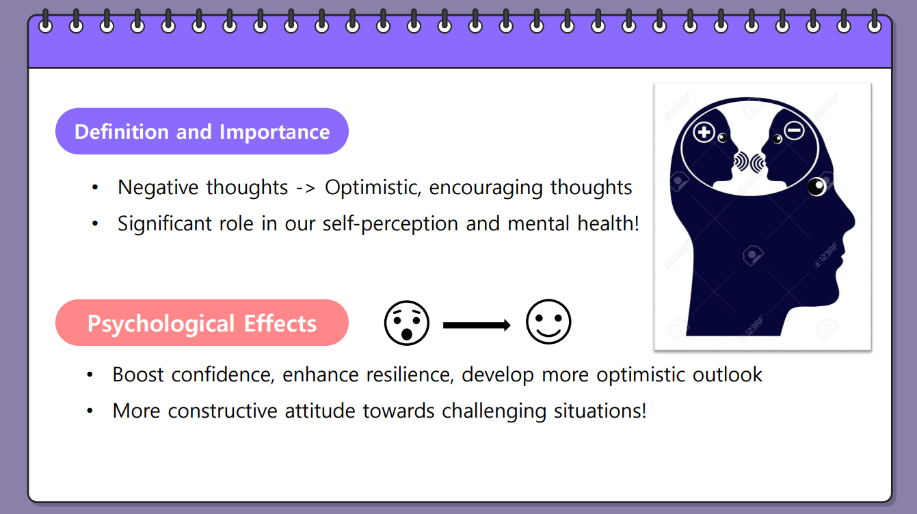

Slide 3


Slide 4


Slide 5
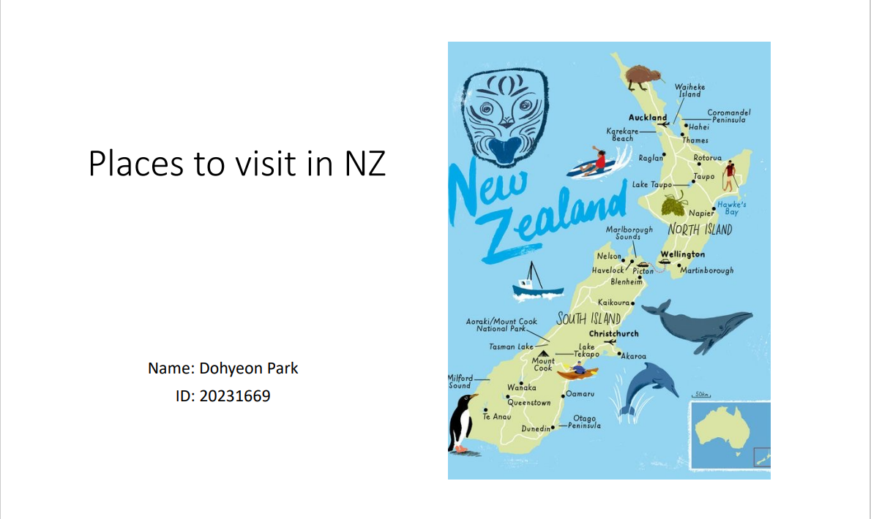

Slide 6
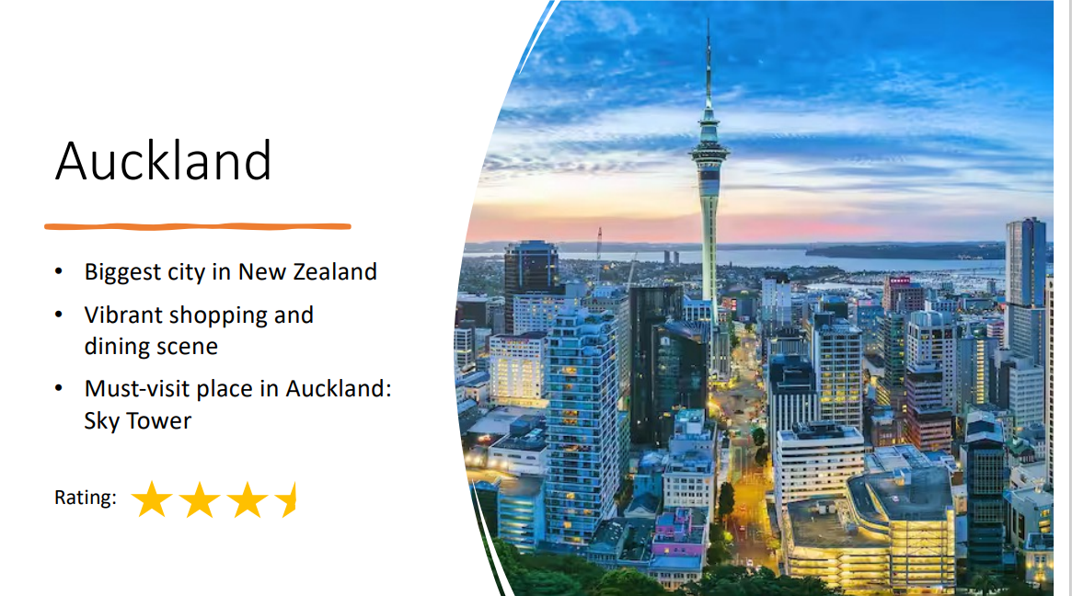

Slide 7


Slide 8
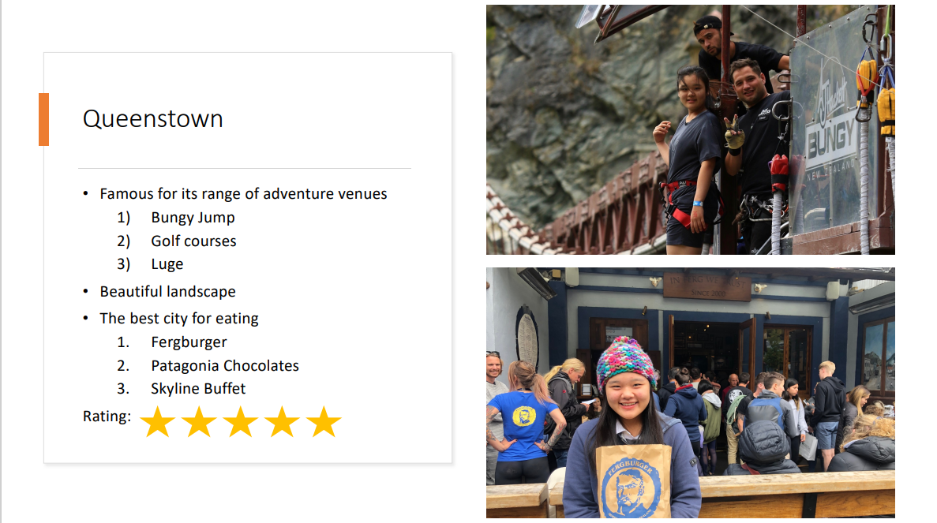

Slide 9


Slide 10



Slide 11
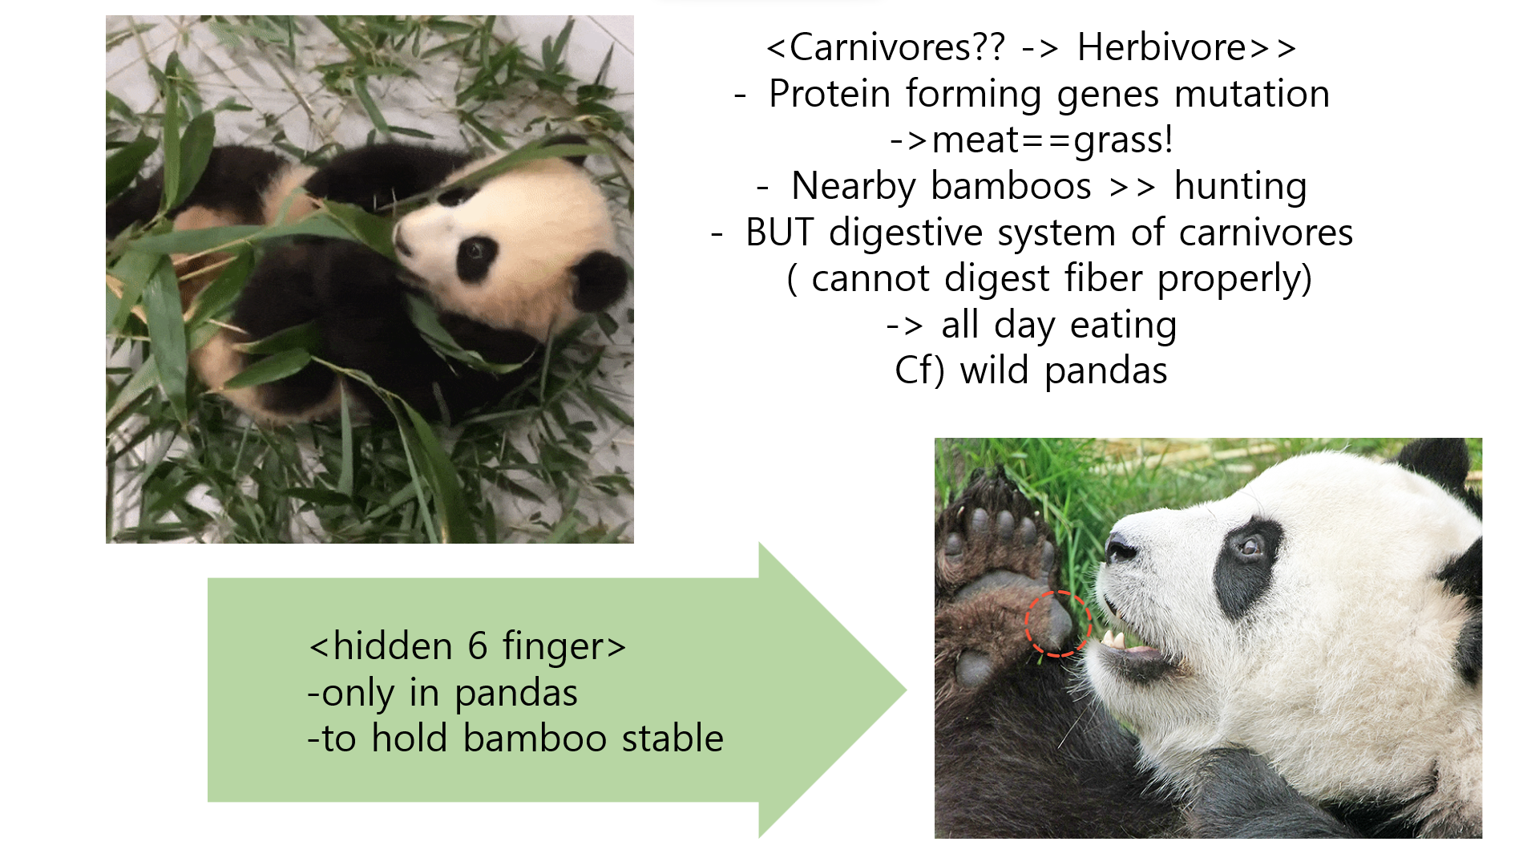


Slide 12



Slide 13
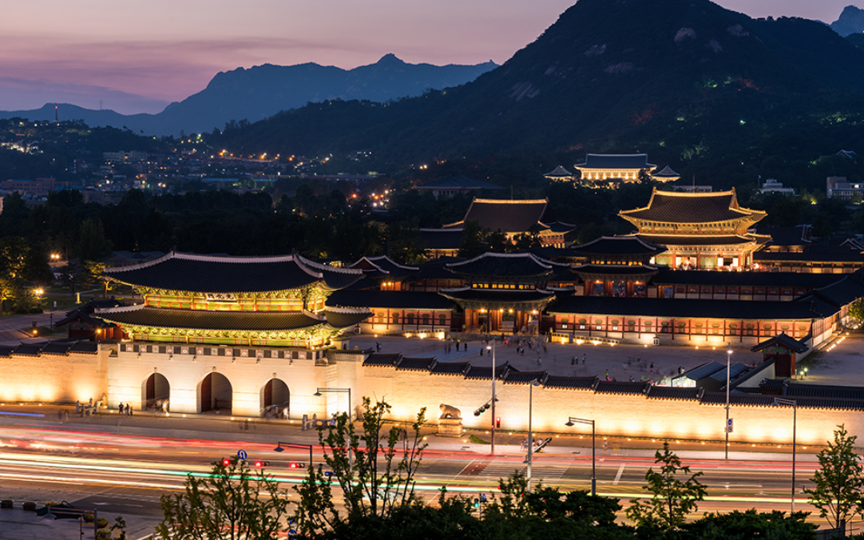
GYEONGBOKGUNG PALACE
20230809 유지민

Slide 14
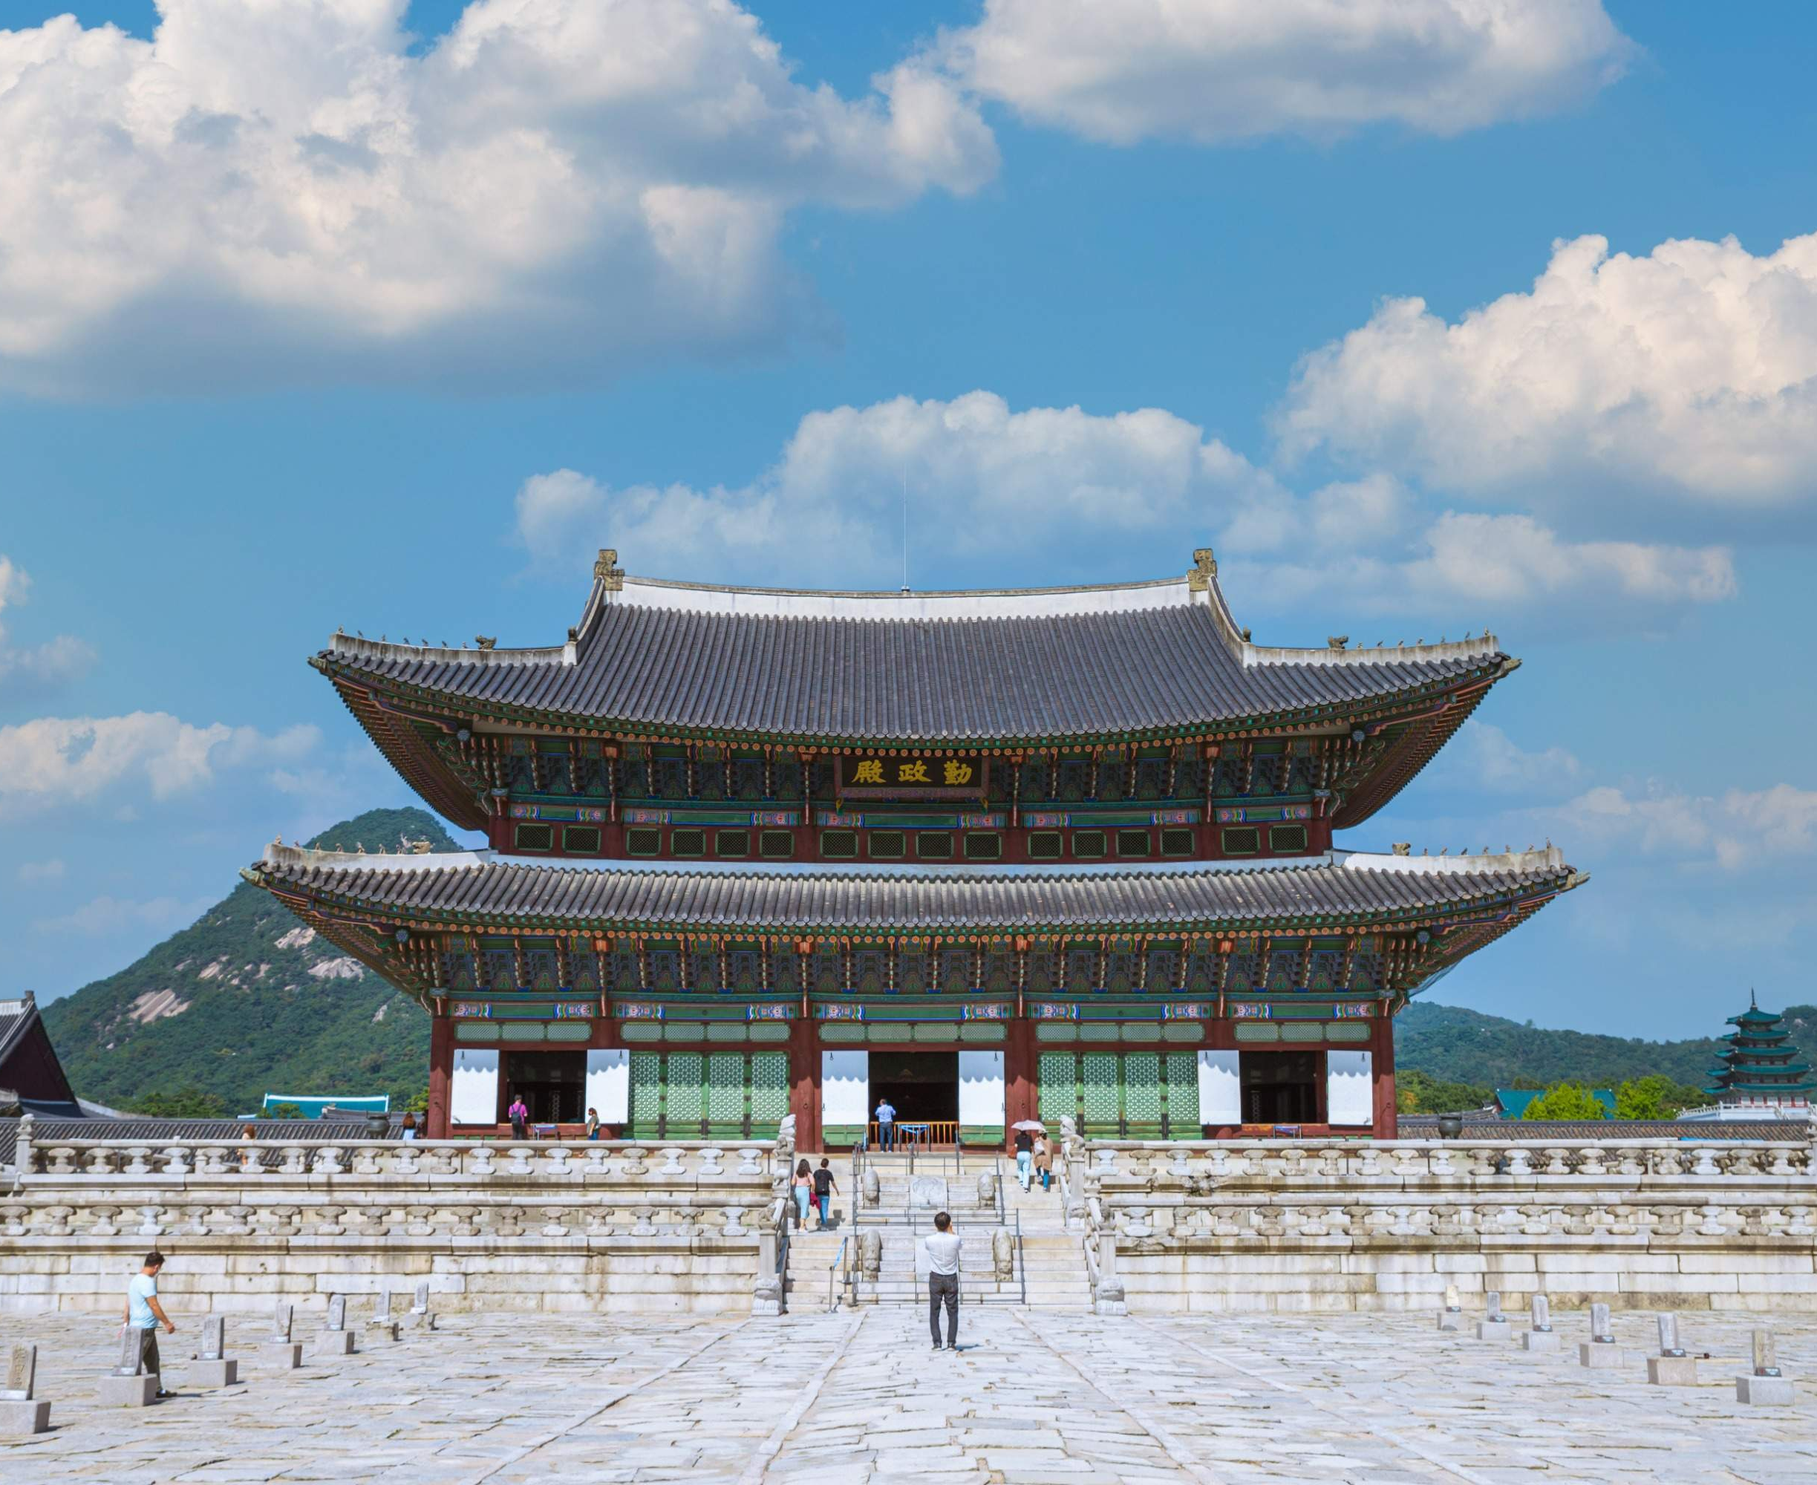
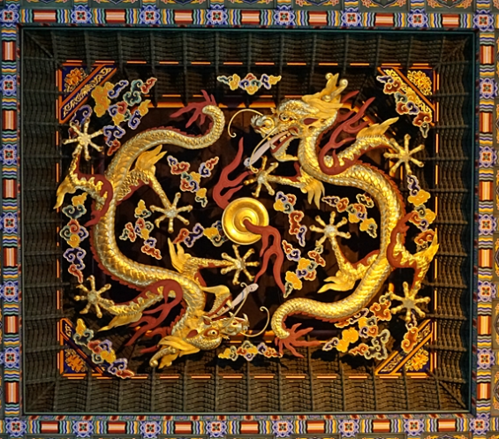
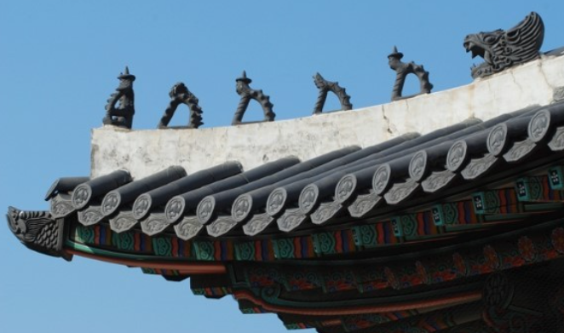
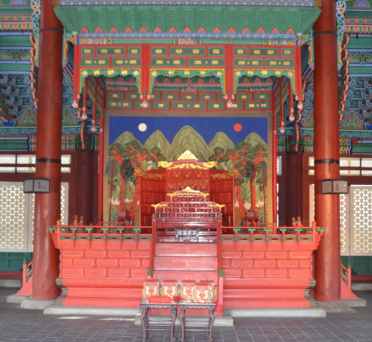

Slide 15
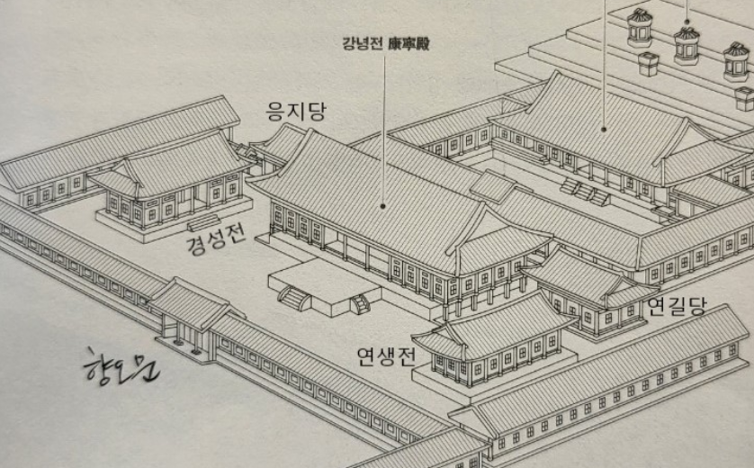
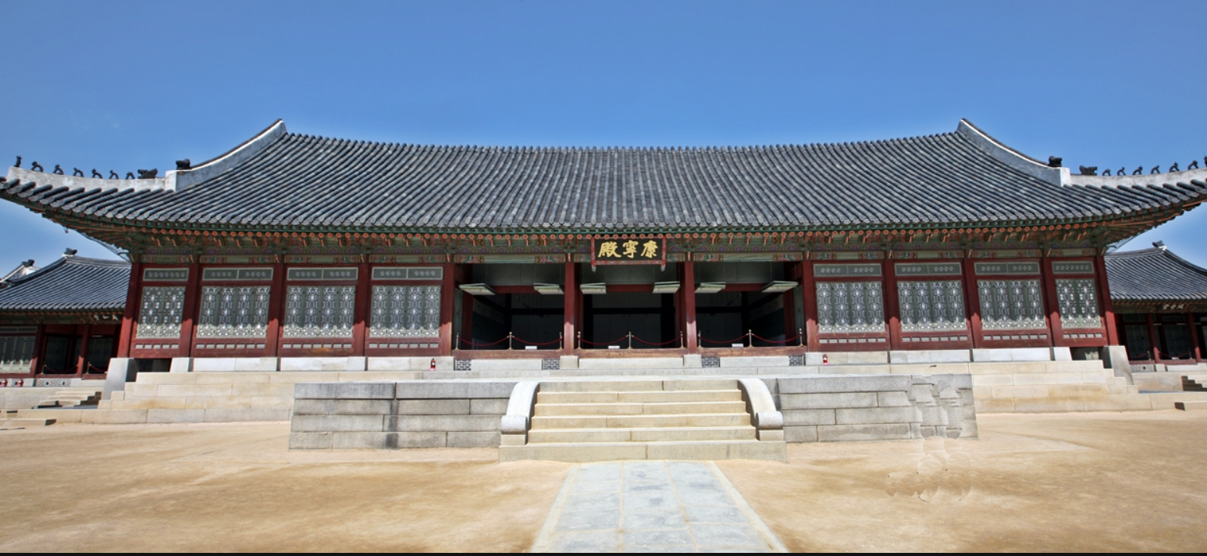

Slide 16
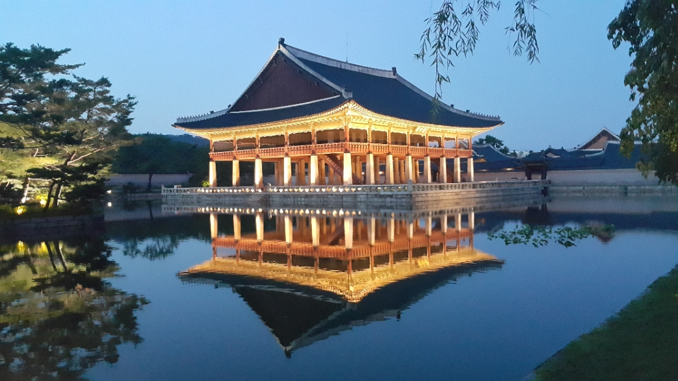

Slide 17

Enchanting Cities: Prague, Salzburg, and Český Krumlov in Europe
20231130
Gyuri Hahn

Slide 18
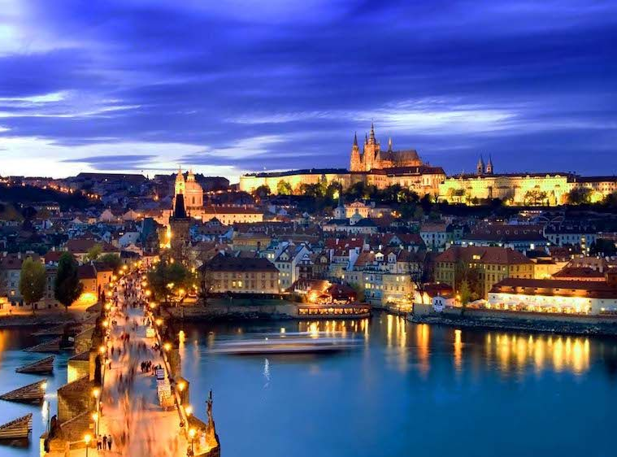
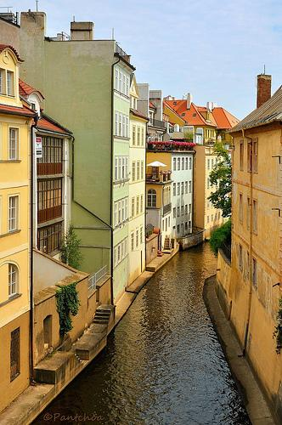
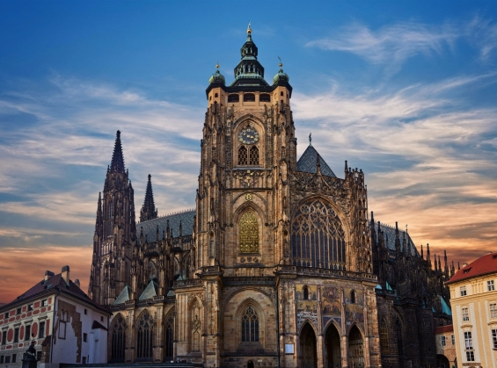
Prague
famous for its architecture and history
Charles Bridge
Prague Castle:
palaces, museum, cathedral
Kampa Island
peaceful scenery, riverside walk, view of the Charles Bridge

Slide 19
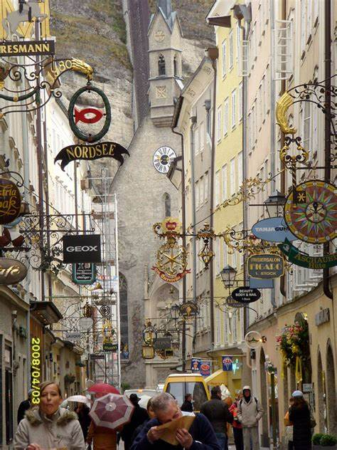
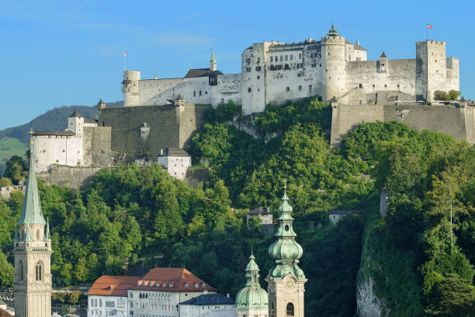
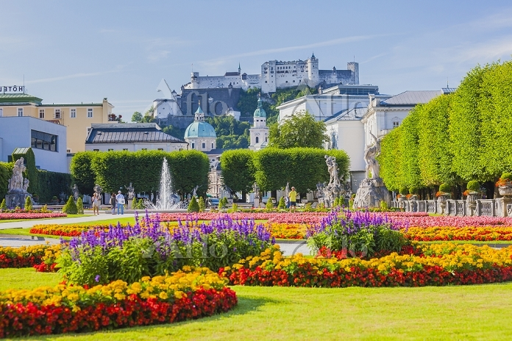
Salzburg
Panoramic city view
Getreidegasse street filled with shopes.

Slide 20
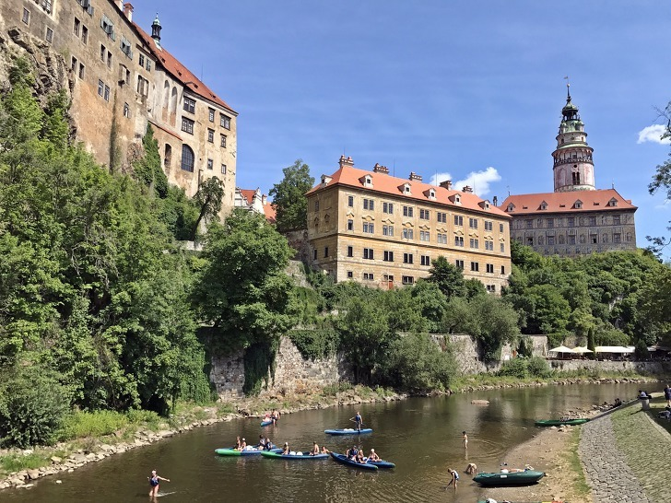
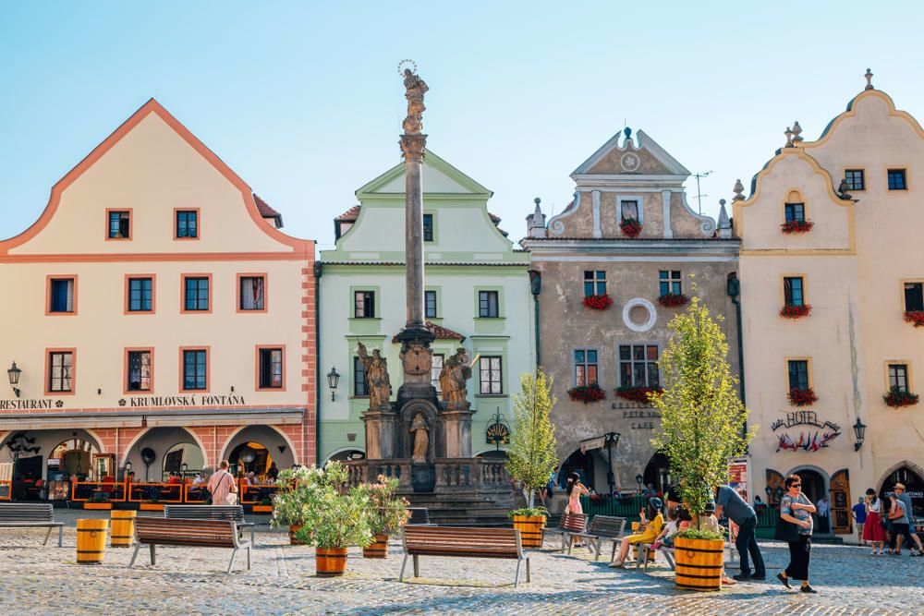
Český Krumlov
Fairytale-like town in Czech, medieval, Baroque theater
Svornosti Square
outdoor cafes, local vendors

